Slide 1
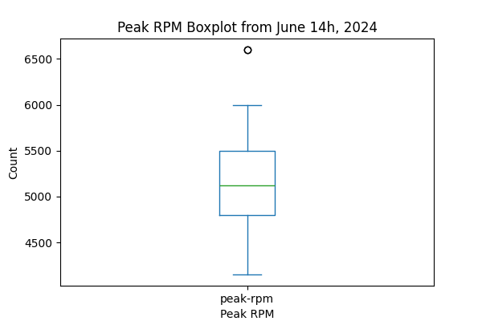
Peak RPM Boxplot

